Slide 1
How do we know what stellar thermonuclear reaction rates are?
Philip Adsley padsley@tamu.edu
Texas A&M University
Department of Physics & Astronomy
Cyclotron Institute

Slide 2
Outline (all days)
What are stars and how do they work?
Nucleosynthesis in stars
Going from nuclear data to thermonuclear reaction rates – an experimentalist’s guide

Slide 3
Outline (today)
Going from nuclear data to thermonuclear reaction rates – an experimentalist’s guide
What information do we need in order to know a reaction rate?
Computing reaction rates – with particular focus on charged-particle reactions on light-ish nuclei (A<40)
Special cases – triple α, WEIRD STUFF to check

Slide 4
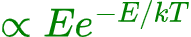
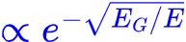
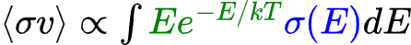
𝛾
Nuclear reaction rates
How fast do reactions happen in stars?
Have a range of energies with which collisions take place and we need to take that into account
Distribution of energies: Maxwell-Boltzmann
How likely is it that a reaction takes place at each energy: cross section which depends strongly on the penetration through the Coulomb+angular momentum barrier
Add up (the probability of interaction at each energy) * (the probability of having two particles with that relative energy)
If we are feeling fancy, we can write this as an integral but please don’t obsess about the maths
Before
After
Gamow window
Probability
kT
E₀

Slide 5
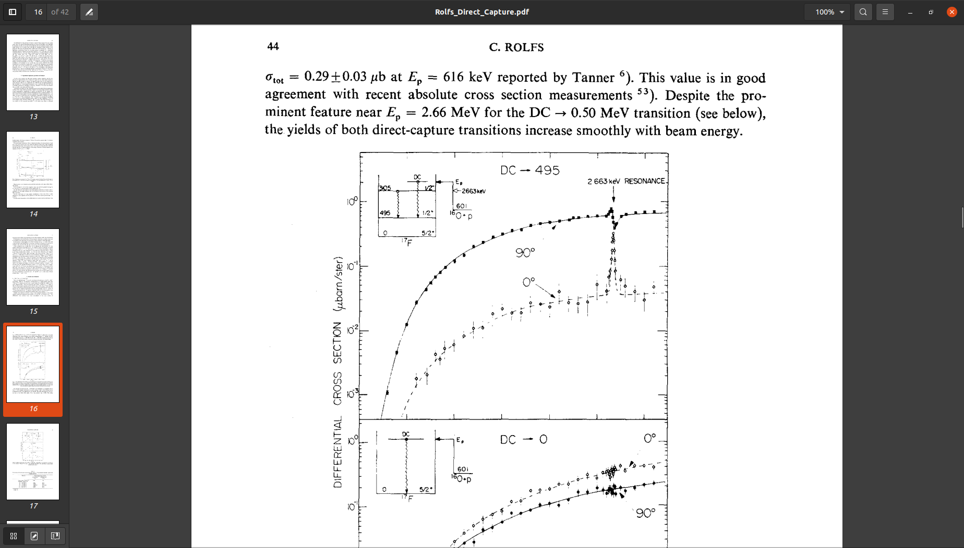
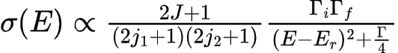
Cross Section Components
Two main ways reactions happen:
Direct capture into some bound state - smooth dependence with energy
Resonance reactions - forming some excited “nearly bound” state in the compound nucleus for a while which can then decay into the reaction products
Resonances characterised by certain parameters: energy, spin and parity, partial widths (decay rates into different channels)
HUGE generalisation: the partial width we care most about is usually the smallest
For broad resonances, especially with tails, the total width can be very important as well
Rolfs Nuclear Physics A 217 29-70 (1973)

Slide 6


Direct capture
Proceed directly (!) from a scattering state to a bound state
1-step process
Slooooowwwwww
Leads to smooth energy-dependent cross section
E_{cm}
¹⁶O+p
495, 1/2⁺
G.s. 5/2⁺
¹⁷F

Slide 7
Resonance reactions
Two-step process
First formation of a compound resonance state
Decay of the resonance state
Characterised by energy, spin and parity, partial widths (branching ratios)
Typically much strong than direct capture
E_{cm}
¹⁶O+p
495, 1/2⁺
G.s. 5/2⁺
¹⁷F

Slide 8
Energies
States can give rise to resonances
Since there is a exp(-E/kT) term in the rate for a resonance, the resonance energy matters a lot
This means that need to know excitation energy AND masses
Rolfs Nuclear Physics A 217 29-70 (1973)

Slide 9
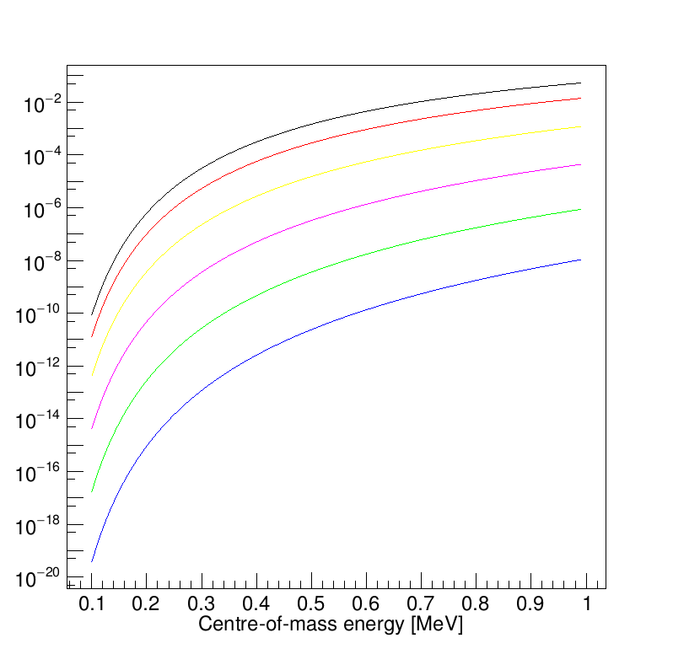
Spin and parity
Spin and parity matter
Spin comes in as 2J+1 factors in the cross section
Spin and parity for fusion – low angular momentum dominates and spin/parity tell us which state can be important for fusion reactions
ℓ=0
Penetrability
ℓ=5

Slide 10


Widths &c.
Width is 1/lifetime – decay rate
Total width (total decay rate) is sum of decay rates into each channel
Branching ratio = what proportion of the decays are into each channel
$$Γ= \sum{Γ_{i}}$$
$$B_{i}=\frac{Γ_{i}}{Γ}$$

Slide 11
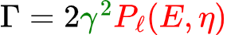
Partial Widths
Two main contributions to the partial widths (think of them as decay rates or lifetimes to decay in a particular channel)
There’s a nuclear structure part (green) which describes how much like that channel the compound state looks
The penetrability is the probability of making it through the barrier given the energy (E), the Coulomb barrier information (Sommerfeld parameter, 𝜂) and the angular momentum potential barrier (ℓ)
The angular momentum barrier has a big effect on the barrier penetrability! Nuclear astrophysics is a low-spin game, ℓ=0-2 dominates resonance reactions
How quick the decay is
All the nuclear structure information
Barrier penetration: how likely is a particle to make it through the barrier, depends on charges and angular momentum barrier

Slide 12
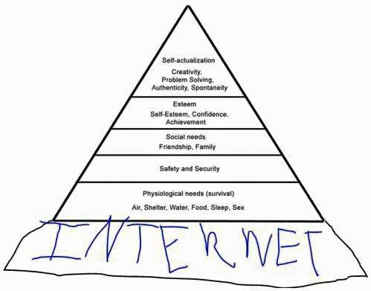
The Hierarchy Of Needs
Maslow
𝛤/𝜔𝛾
Me
C²S, BRs
J^{𝜋}
E_{x}/E_{r}
How many states?

Slide 13
The Hierarchy Of Needs
We need to know
If there are levels? Enough for statistical models?
Where they are
What their spin/parity is? Can they possibly contribute to the reaction rate
Their actual contribution to the reaction rate
𝛤/𝜔𝛾
Me
C²S, BRs
J^{𝜋}
E_{x}/E_{r}
How many states?

Slide 14
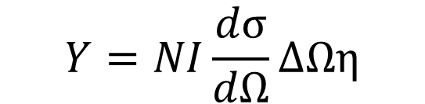
Experiments – direct studies
Ultimately we want cross sections so just measure them
Beam on target, measure yield per incident ion
Need to know efficiency of detection
Target areal density (thickness)
Number of incident ions
Yield is often extremely small ~0
BEAM
Target
Radiation produced
$$Y=NI\frac{dσ}{dΩ}ΔΩη$$
Detector

Slide 15
Experiments – “thick” and “thin” targets
Ultimately we want cross sections so just measure them
BUT we don’t measure cross sections, we count hits
If we have a target which has a wide energy range compared to the resonance of interest, measure ~integrated cross section
Call this thing the resonance strength
Thick is a relative term but reactions only in one section of the target is a reasonable definition
BEAM
Target – beam is losing energy
Resonance at this energy
Beam energy
Depth into target
Number of reactions at each depth
Depth into target

Slide 16
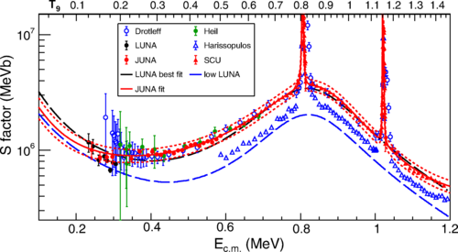
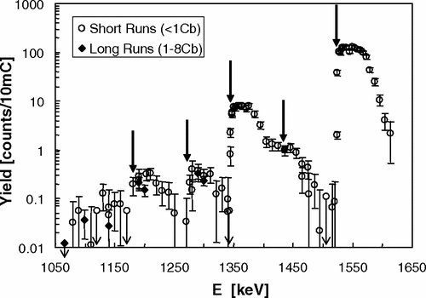
Experiments – “thick” and “thin” targets
Ultimately we want cross sections so just measure them
BUT we don’t measure cross sections, we count hits
If we have a target which has a wide energy range compared to the resonance of interest, measure ~integrated cross section
Call this thing the resonance strength
Thick is a relative term but reactions only in one section of the target is a reasonable definition

Slide 17
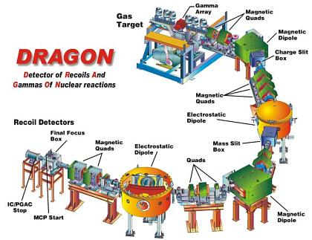
Experiments – direct studies with separators
Most of the time we measure light ions/neutrons (gross)/gamma rays from reactions
Can also measure the heavy thing with separators
Vital for radioactive beams since those are heavy beams on light targets
DRAGON @ TRIUMF
SECAR @ FRIB
Saint George @ Notre Dame
ERNA

Slide 18
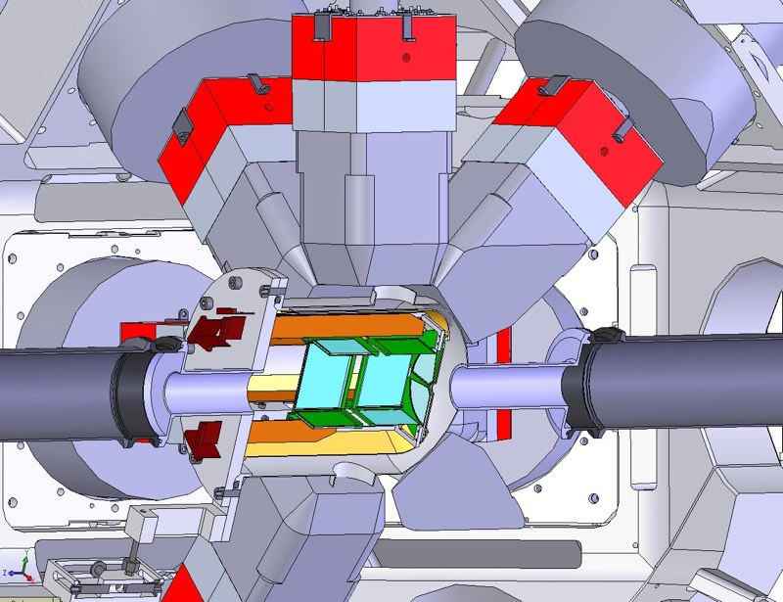
Experiments – indirect studies
Yield from direct measurements is often extremely small ~0
Can calculate the reaction rate if we have spectroscopic information
If we know information like if states exist, excitation energy, and spin and parity (therefore orbital angular momentum) we can work out which states might be important
Target direct measurements or plan indirect studies
Silicon+HPGe
SHARC/TIGRESS(+EMMA)
T-REX/Miniball
GODDESS (Argonne/FRIB)

Slide 19
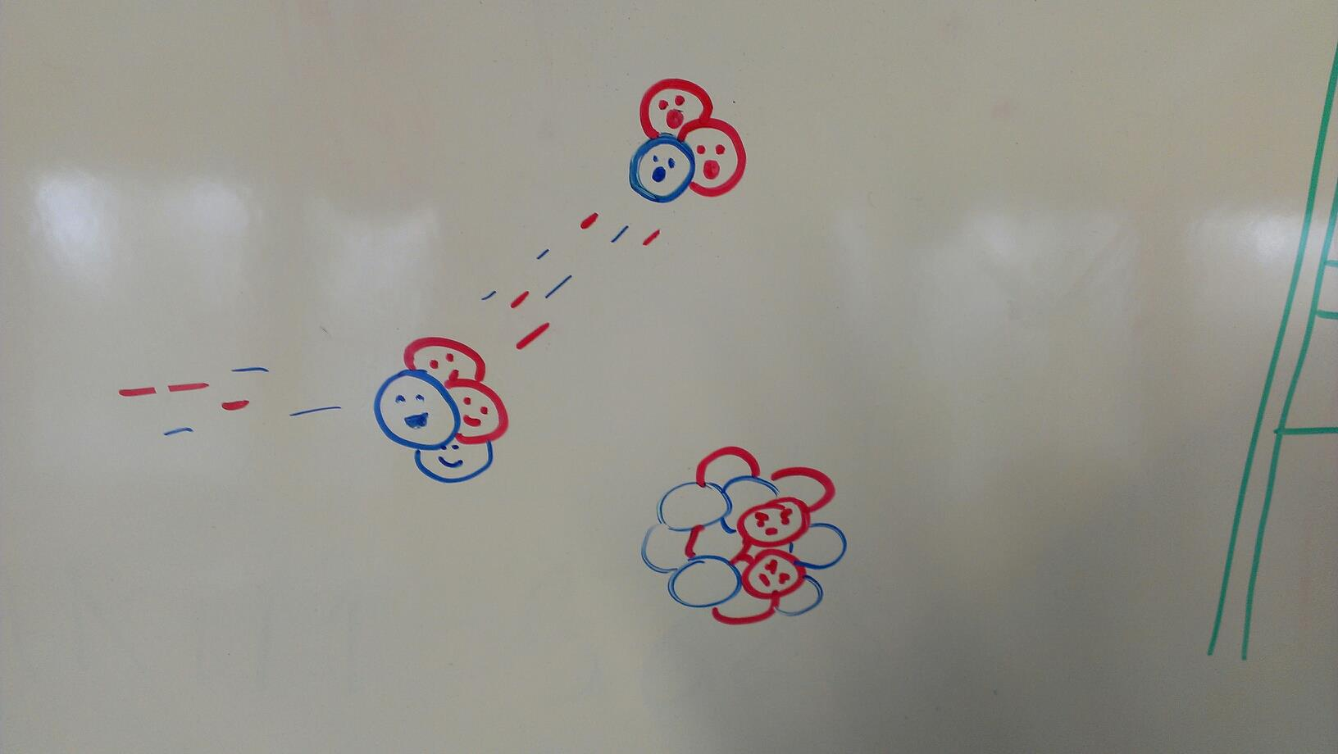
Experiments – transfer reactions and nuclear data
I want to use transfer reactions as my example (pay attention, FRESCO people)
We can do lots of things with them including
-finding states and getting their energies
-constraining spins and parities
-inferring partial widths from transfer reactions
Richard Longland

Slide 20
Theory of transfer reactions
Assume the following:
Entrance and exit channels dominated by elastic scattering
Transfer is weak - treat as first-order perturbation
Transfer proceeds directly between two channels
Direct transfer into the final state with no other rearrangement of the core
Consider a reaction like A(x,y)B where x = y+c and c is a cluster which gets transferred
Using potentials to describe interactions e.g. x = y+v is held together with a potential, A and x have some interaction between them
y
x = y+c
B = A + c

Slide 21
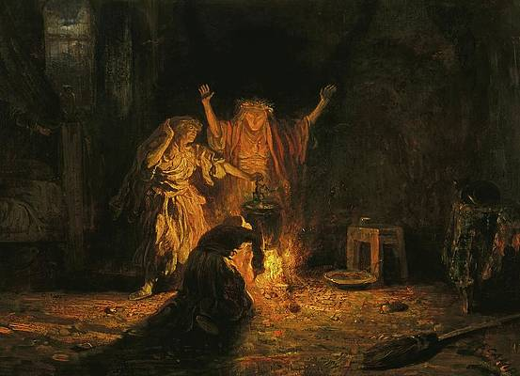
Theory of transfer reactions
Some necessary ingredients
Optical-model potential for outgoing distorted waves (from elastics)
Optical-model potential for incoming distorted waves (from elastics)
Overlap function - usually single-particle states in a Woods-Saxon potential with adjusted depth
Transfer operator - what potential describes the actual transferring part
Initial and final states (energies, spins, parities), masses, beam energy etc

Slide 22
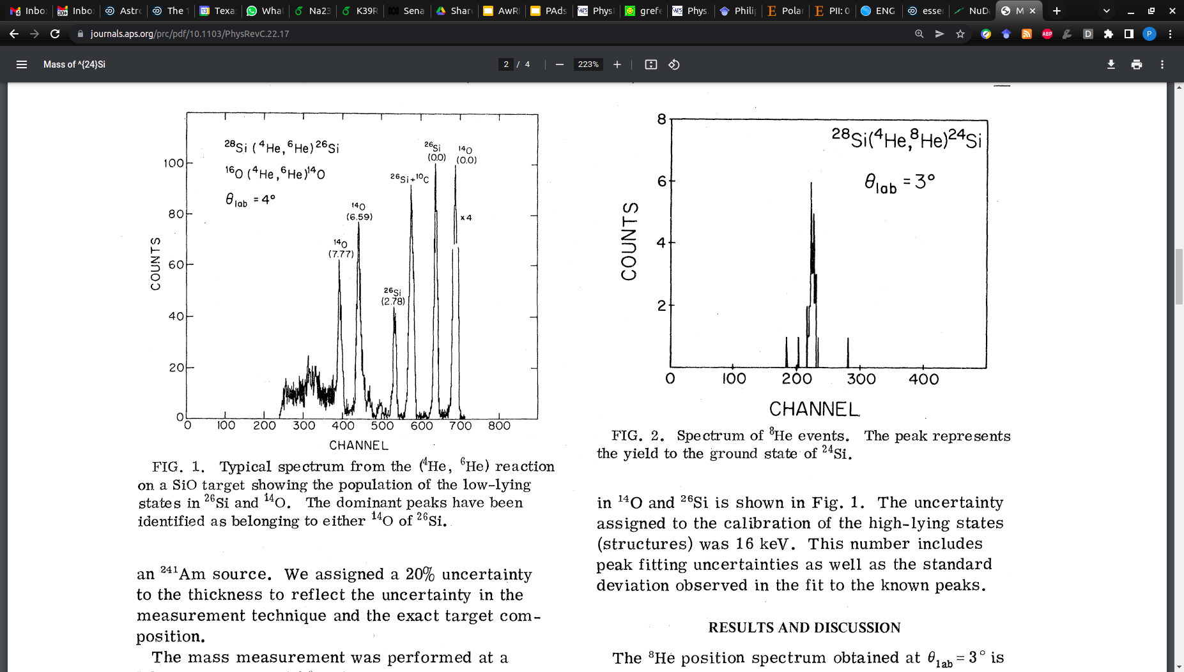
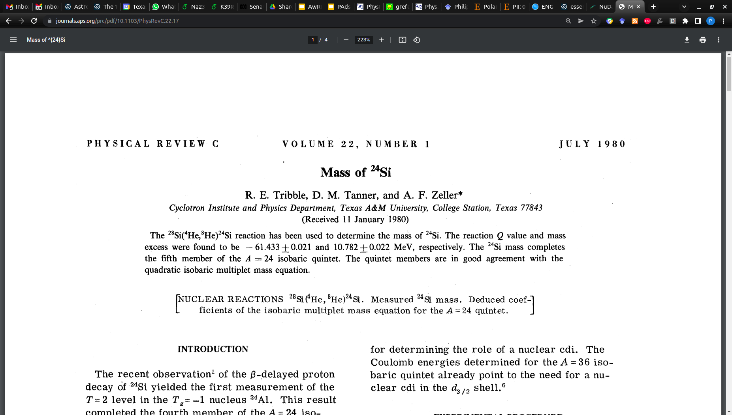
Transfer reactions for E_{r}
The first and most basic task is to work out if there are states in a nucleus!
Generally we can do this at the same time as working out some other things like spins and parities but not always
Back before RIB+Penning traps were a thing - mass measurements using transfer reactions
Can find excited states by the same process (which traps generally cannot)

Slide 23
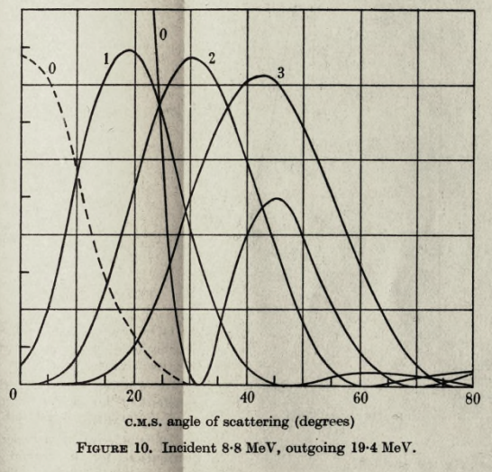
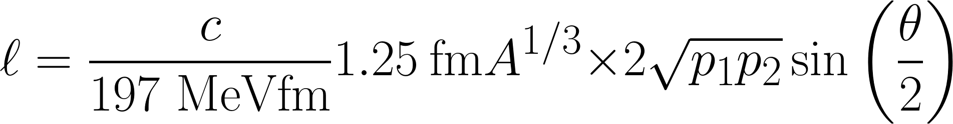
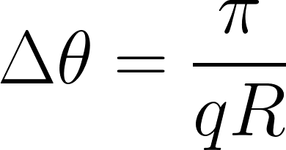
Transfer reactions for J^{𝜋}
The shape of the angular distribution is characteristic of the orbital angular momentum transferred
The momentum transferred (q) is the difference between momentum in (p₁) and out (p₂), and the orbital AM is L=rq
Can do a quick classical calculation (I think the full derivation is in Krane):
Then choose the L-value of interest and work out the angle at which the classical condition is satisfied… which works surprisingly well
Interference: gap between maxima:
BUTLER, S. T., Proc. R. Soc. (London) A208, 559 (1951)

Slide 24
Transfer reactions for L/J^{𝜋}
The shape of the angular distribution is characteristic of the orbital angular momentum transferred
The momentum transferred (q) is the difference between momentum in (p₁) and out (p₂), and the orbital AM is L=rq
Can do a quick classical calculation (I think the full derivation is in Krane):
Path difference for constructive interference = 2𝜆
2R𝜃 = n𝜋
Then choose the L-value of interest and work out the angle at which the classical condition is satisfied… which works surprisingly well
Interference: gap between maxima:

Slide 25
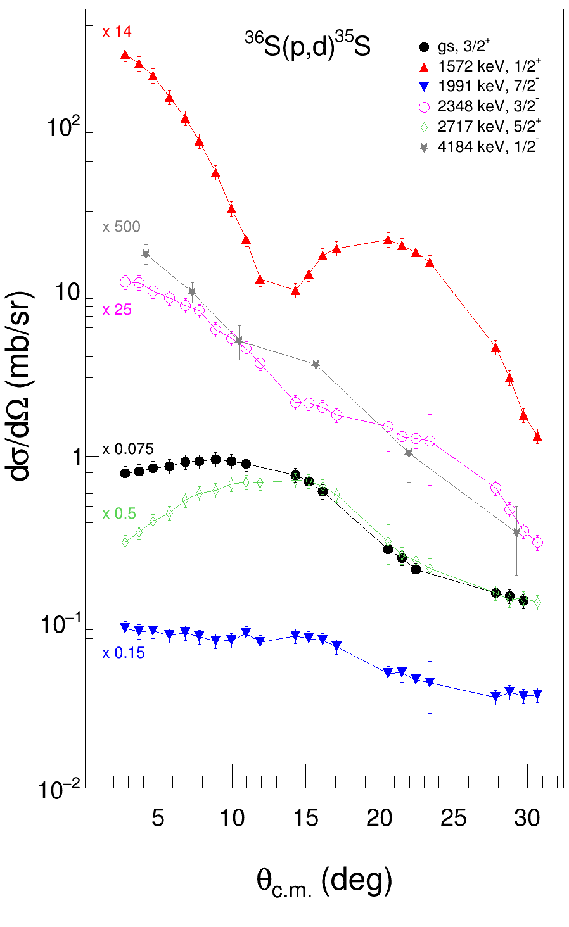
J^{𝜋} and L
Telling different spins apart from single-nucleon transfer is difficult
L transfer much more clear but then J=L±½
Can get around this by using polarised beams!
Some differences due to spin-orbit effects but don’t rely on it
Proton and neutron in polarised deuteron
Target populating
J = L-½ state
Cross section for a spin-up deuteron is higher than for the spin-down deuteron for an L-½ state
Fig courtesy Sandile Jongile+Retief Neveling

Slide 26
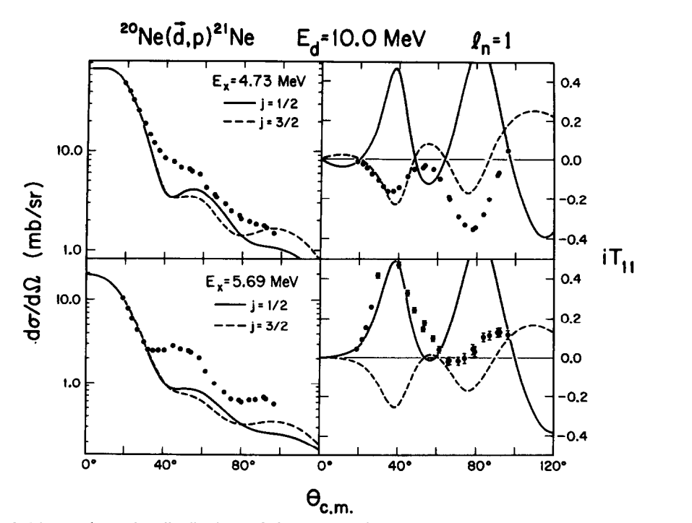
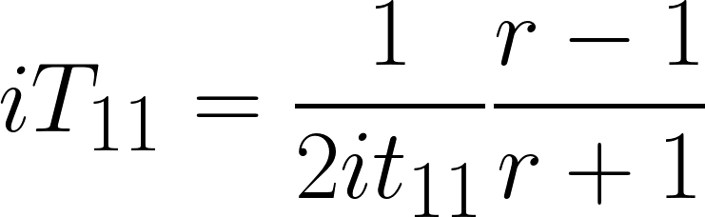
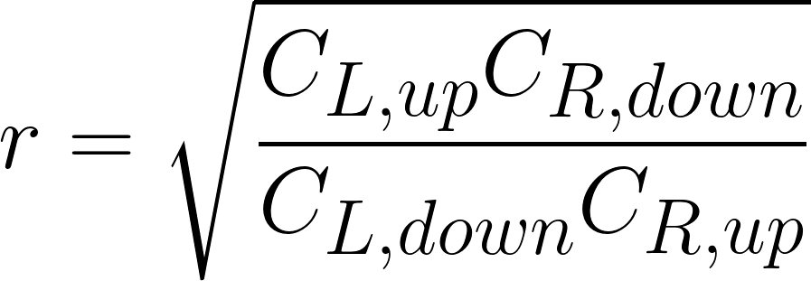
J^{𝜋} and L
Telling different spins apart from single-nucleon transfer is difficult
L transfer much more clear but then J=L±½
Can get around this by using polarised beams!
Some differences due to spin-orbit effects but don’t rely on it
Fig courtesy Sandile Jongile+Retief Neveling

Slide 27
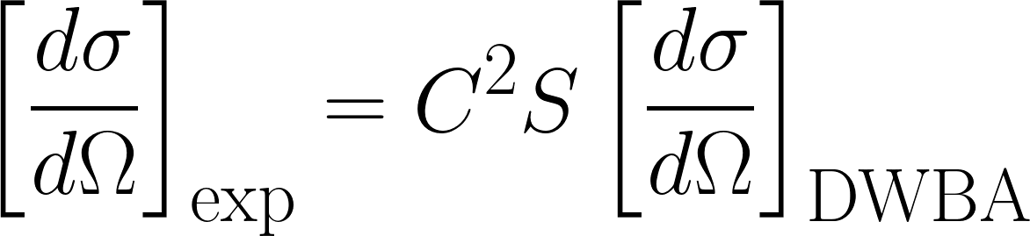
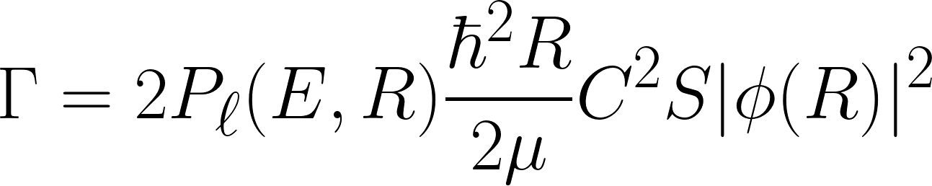
Computing widths from transfer reactions
How likely we are to get through the barrier
Can determine the partial width for a particle to decay from a nucleus
Hand-wavy explanation: how likely the particle is to appear at the surface of the nucleus x how likely the particle is to make it out through the barrier
Some boring constants
The scaling factor for the wavefunction
The size of the single-particle wavefunction at the nuclear surface

Slide 28
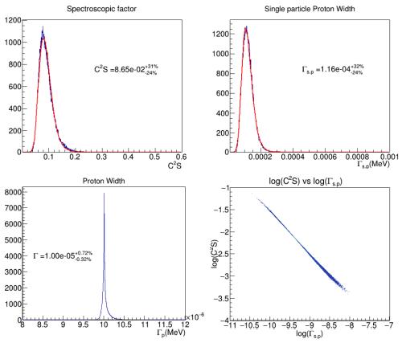
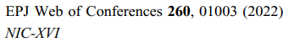
Computing widths from transfer reactions
The spectroscopic factor and the single-particle partial width both depend on the binding potential used
Negatively correlated!
Their product is less uncertain than each of them are independently
Means that we end up with a smaller uncertainty on the width than each of the spectroscopic factor and single-particle width independently

Slide 29
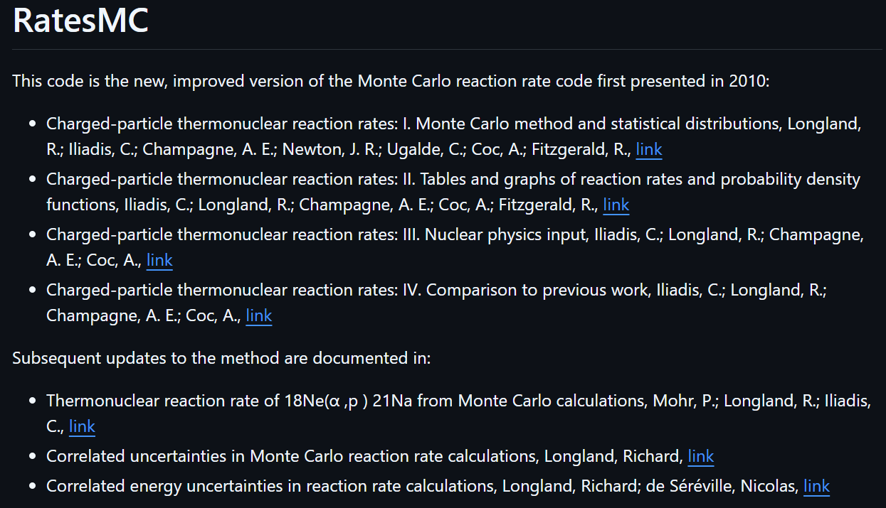
How to calculate the reaction rate?
With a computer ☺
There are tools which you can use
I use RatesMC (NC mafia)
Includes uncertainties on nuclear reaction data such as
-Gaussian distributed resonance energies
-Log-normally distributed widths/resonance strengths
Unknown unknowns obviously not included
https://github.com/rlongland/RatesMC

Slide 30
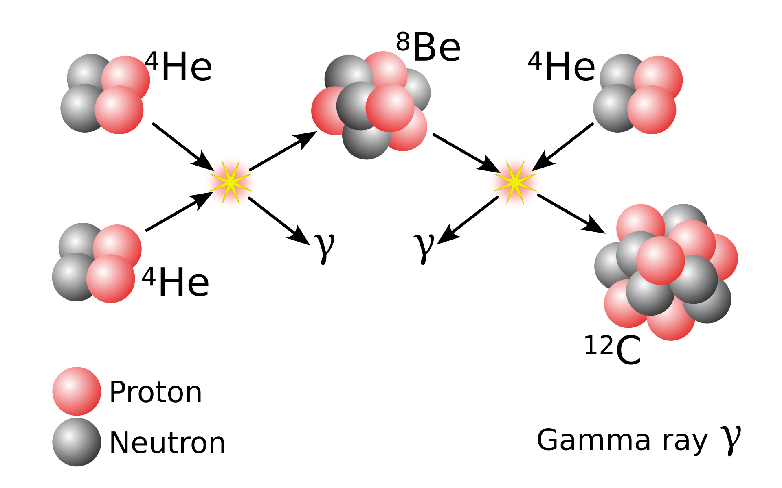
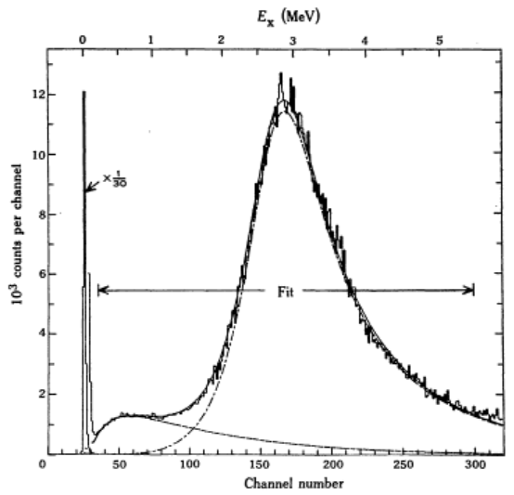
Special cases – the triple α reaction
People are annoying me by publishing papers with mistakes…
Two-step process through ⁸Be
Form ⁸Be in some equilibrium abundance depending on
-temperature
-α+α -> ⁸Be cross section
The fuse another α onto ⁸Be through the Hoyle state
Have complex behaviour as states are broad and capture through tails is important

Slide 31
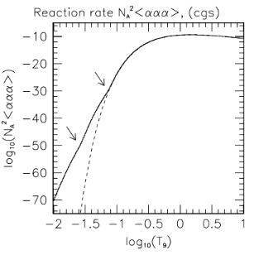
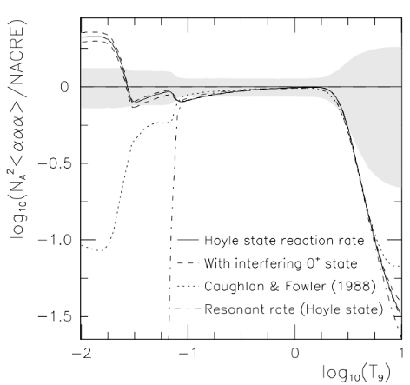
Special cases – the triple α reaction
Have complex behaviour as states are broad and capture through tails is important
At low temperatures, the low-energy tails dominate the contributions to the reaction rate
If you use the narrow resonance formula, you get the wrong answer!
Example – “resonant rate (Hoyle state)
Christian Diget’s* PhD thesis
*my kind-of PhD advisor

Slide 32
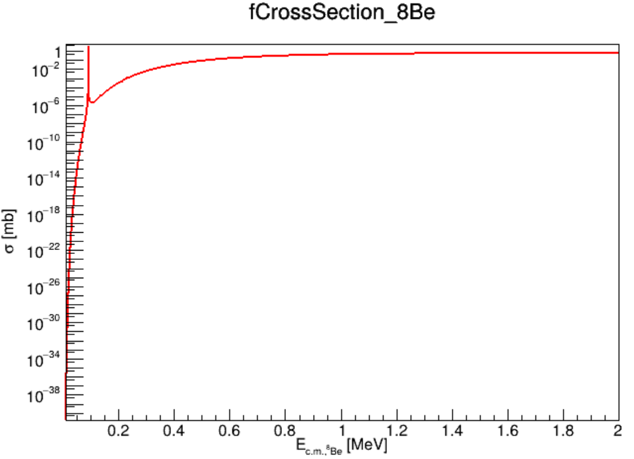
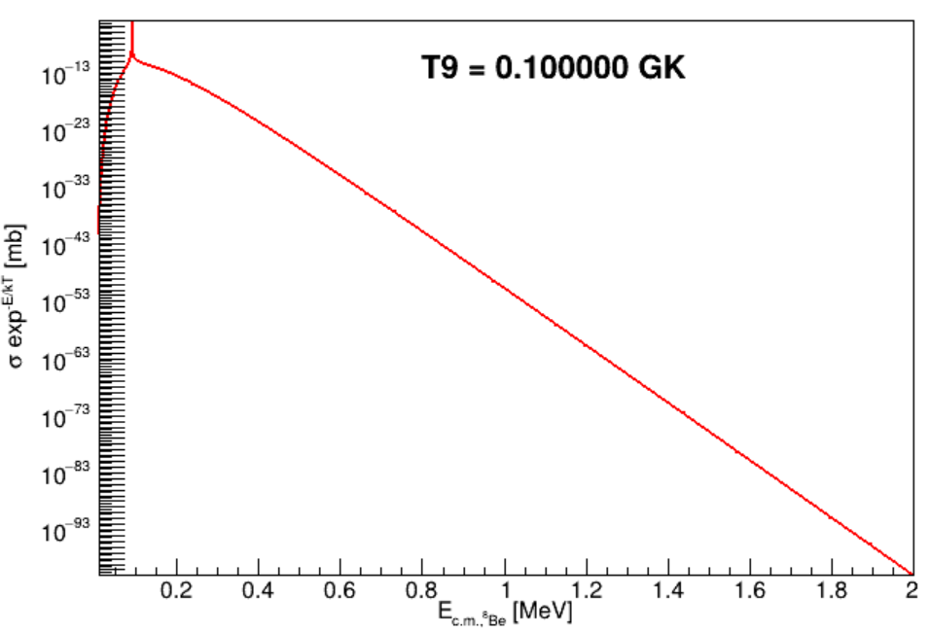
Special cases – the triple α reaction
Have complex behaviour as states are broad and capture through tails is important
At low temperatures, the low-energy tails dominate the contributions to the reaction rate
If you use the narrow resonance formula, you get the wrong answer!
Example – “resonant rate (Hoyle state)

Slide 33
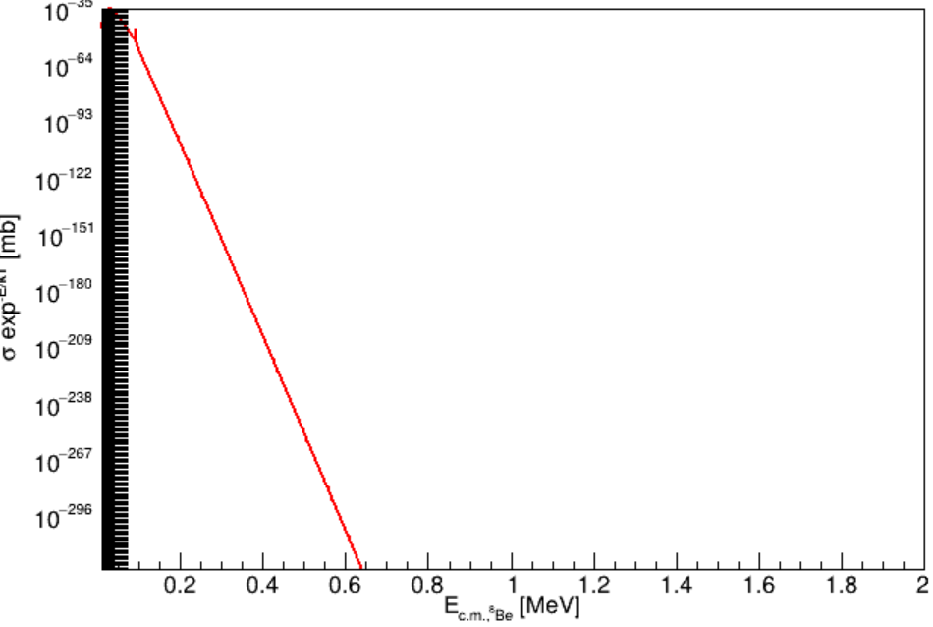
Special cases – the triple α reaction
Have complex behaviour as states are broad and capture through tails is important
At low temperatures, the low-energy tails dominate the contributions to the reaction rate
If you use the narrow resonance formula, you get the wrong answer!
Example – “resonant rate (Hoyle state)
T = 0.01 GK

Slide 34

Special cases – the triple α reaction
Have complex behaviour as states are broad and capture through tails is important
At low temperatures, the low-energy tails dominate the contributions to the reaction rate
If you use the narrow resonance formula, you get the wrong answer!
Example – “resonant rate (Hoyle state)
T = 0.01 GK

Slide 35
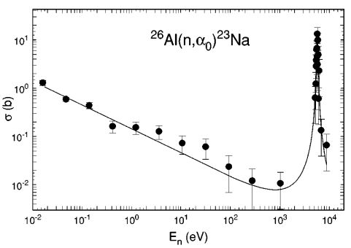
Special cases – neutron-induced reactions
Neutron-induced reactions have characteristic tails in their cross sections
The s-wave neutron component – no Coulomb barrier but s means L=0 so no angular-momentum barrier
This, combined with the Maxwell-Boltzmann distribution means that the reaction rate is flat

Slide 36
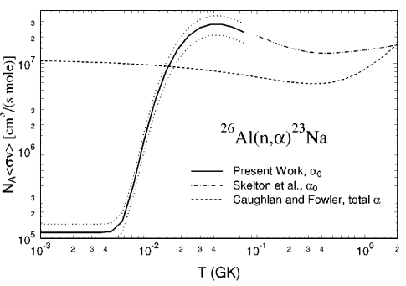
Special cases – neutron-induced reactions
Neutron-induced reactions have characteristic tails in their cross sections
The s-wave neutron component – no Coulomb barrier but s means L=0 so no angular-momentum barrier
This, combined with the Maxwell-Boltzmann distribution means that the reaction rate is flat

Slide 37
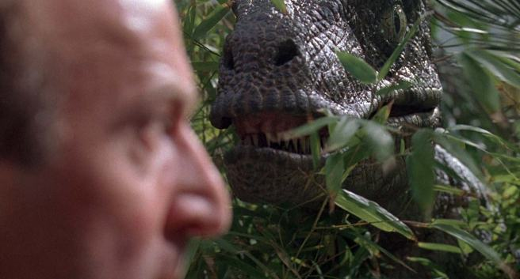
Evil things lurking in the undergrowth
Reaction rates are weird – the Boltzmann factor is a constant source of confusion
E.g. you may have a narrow resonance at higher excitation energy which may STILL be the largest contributor at low temperatures because the tail is dominant
The narrow-resonance formula fails sometimes and does so quietly
Christian Diget’s* PhD thesis
*my kind-of PhD advisor

Slide 38
Useful tools
FRESCO is great for transfer and it gives us wavefunctions for our calculations <3
DWUCK4 allows transfer to unbound states with computed widths as well (find my Github “padsley” if you want to try DWUCK4)
RatesMC (also on Github) is a great tool for calculating reaction rates with uncertainties (Richard Longland) + STARLIB database
People – ask for help! I’m happy to try to help if you have questions but I’m slow and don’t like ready my emails so be patient

